Slide 1
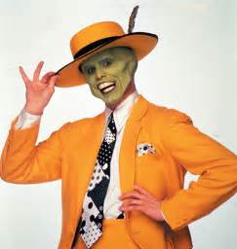
Lets get ready Year 10’s
Bag to the front
Equipment out (pencil, book, calculator, ruler)
Sitting in your assigned seat

Slide 2
Mental set On the left hand side please!
4x18 =
2. 27+668 =
3. 61-89=
4. 39-43=
5. y= 2x+3=17
y= 4x-6+3=41
3c+5g+8c=
5k x 6hj =
Notes:
hook

Slide 3
Lesson objective
By the end of this lesson you will be able to;
- Use Venn diagrams, Tree diagrams and Two Way Tables correctly.
Notes:
Lesson

Slide 4
Quick Write
You have 1 minute
Write as much as you can about Venn diagrams, Two Way Tables and Tree Diagrams.

Slide 5
24
7
30
Probability of a single event?
Date
EQ –What are the important points to remember when using Venn diagrams, Tree diagrams and Two Way Tables?
Two Way Table example
How many people play snooker?
How many people play snooker and piano?
Tree Diagram Example
How many combinations are there?
A survey was undertaken to see if their was a connection between people that play snooker and people that play piano. 63 people play Snooker and piano, 26 people play piano but don’t play snooker, 81 people play snooker but don’t play piano and 16 don’t play either. Represent this information using a two way table.
Mr Morgan is something of shopaholic and is looking at buying 4 shirts (blue, gold, salmon and green), 3 shorts (Adidas, Nike and new balance) and 2 sets of sunglasses (Gucci and Ray-Ban). Unfortunately Mr Morgan is strapped for cash and can only buy one shirt, one pair of shorts and one pair of sunglasses. Create a tree diagram that represents Mr Morgan's options.
5
Notes:
Input

Slide 6
24
7
30
Date
Probability
EQ –What are the important points to remember when using Venn diagrams, Tree diagrams and Two Way Tables?
Venn Diagram
Example
How many Teachers don’t wont like comedy or drama?
Mr Craig wanted to organise a movie night for all 150 teachers at Baldivis. The options were comedy and drama. 44 teachers like drama and 31 of the 88 teachers that like comedy also like drama. Create a Venn Diagram that represents this information.
5
Notes:
Lesson objective (EQ)

Slide 7
Check for understanding
Probability = Number of possible outcomes
Total number of outcomes
Mary is a very active girl and she insists on doing one sport every day. Use either a Venn diagram, two way table or tree diagram to represent the following information.
Cricket and Tee-ball is on Monday.
Squash and Wrestling on Tuesday.
Ballroom dancing and rock climbing on Wednesday.
Volleyball and AFL on Thursday.
Boxing and Soccer on Friday.
How many options does Mary have?
What is the probability of her picking squash?
What is the probability of her doing wrestling and AFL?
What is the probability of not doing tee-ball?
Notes:
Check for understanding

Slide 8
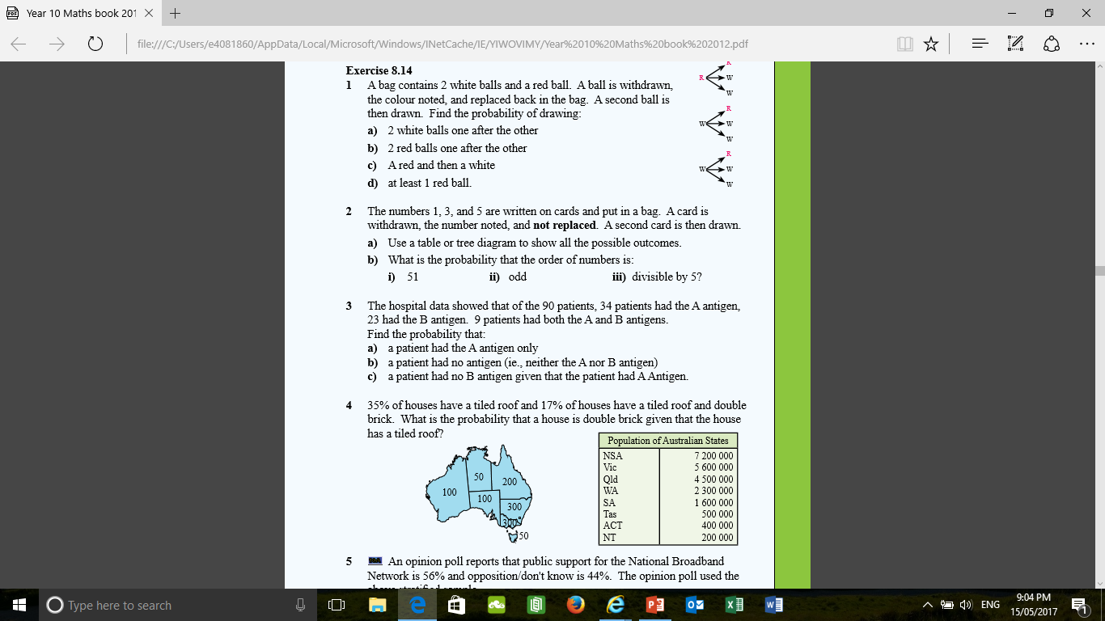
Lets see what you can do.

Slide 9
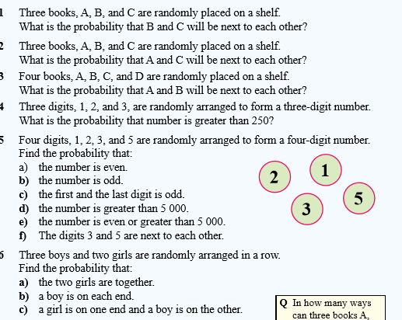

Slide 10
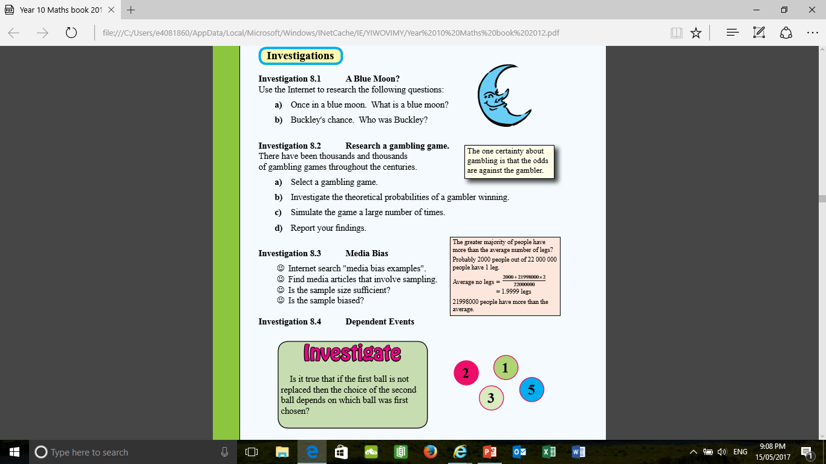
Extension Activity

Slide 11
Thumbs up, down or sideways Checking for Competency
Thumbs up – I got it, this makes sense. I'm the bomb.com.
Thumbs sideways –I need a little more practise before I'm ‘rockin’ this.
Thumbs down – I still don’t quite understand probability I need a little more help.
Notes:
Closure

Slide 12
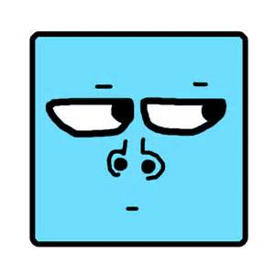
Tutoring
Every Thursday afterschool be there or be

Slide 13
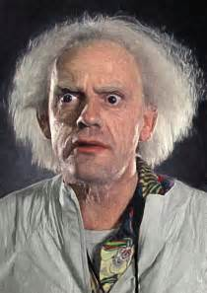
Thankyou and have a Wonderful Day
Trivia Question – Name that movie?

